Slide 1

Hindustan Aeronautics Limited (HAL)

Slide 2
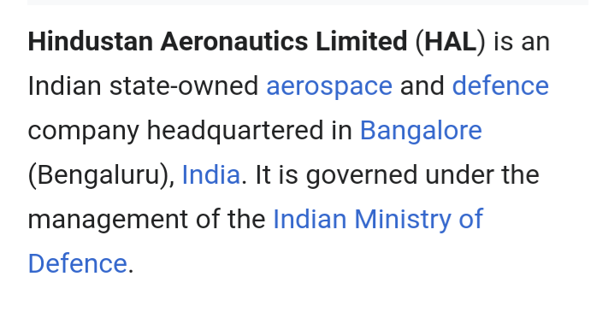
Introduction Of HAL

Slide 3
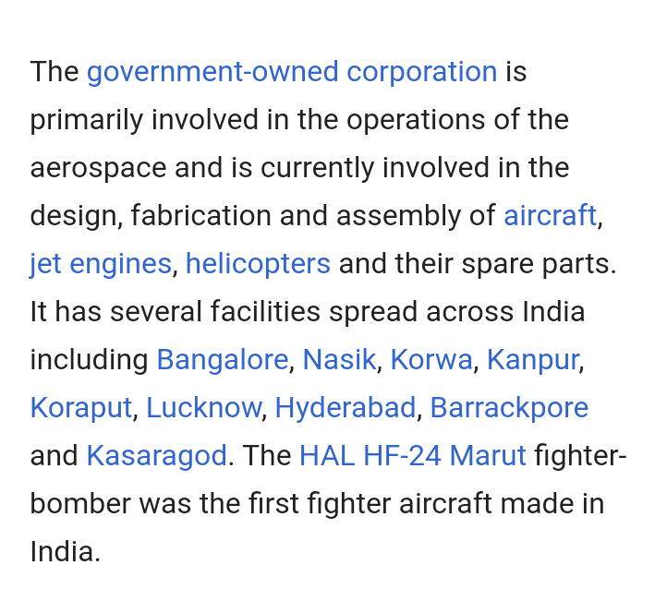

Slide 4
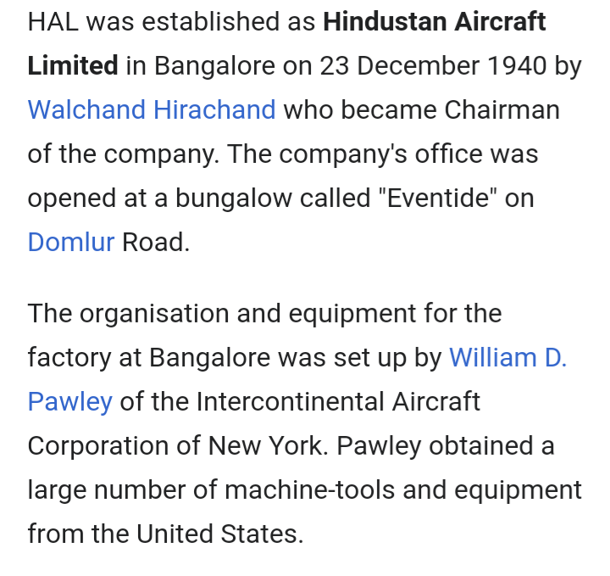
History

Slide 6
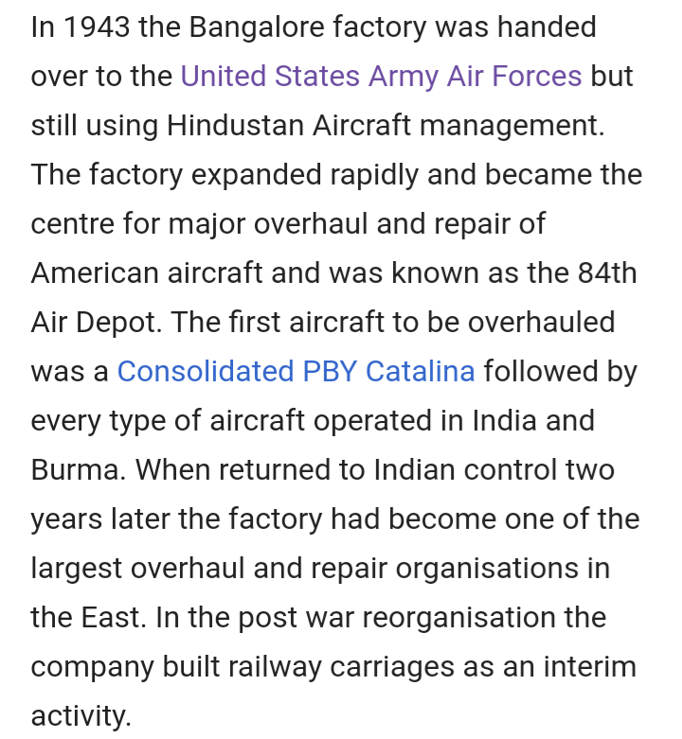

Slide 7
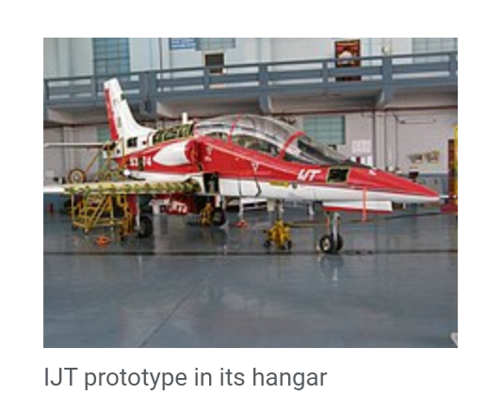

Slide 8
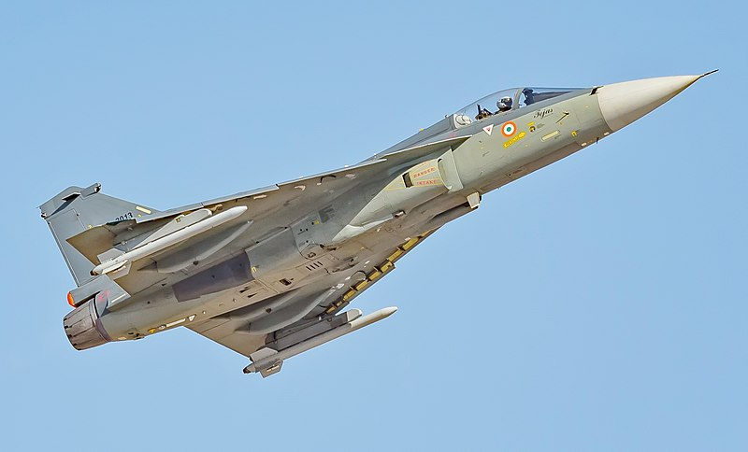
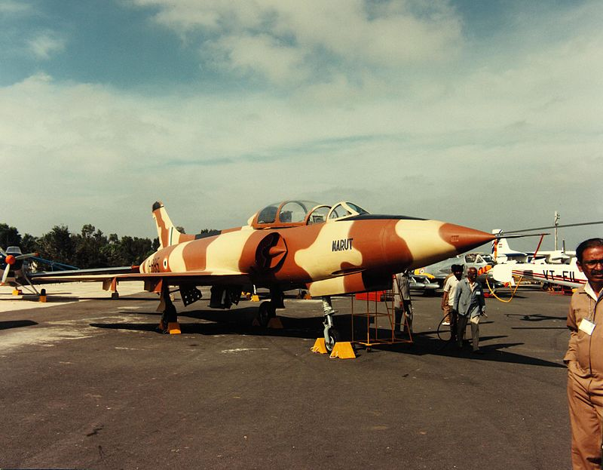
Fighter Aircraft HAL Tejas HF-24 Marut

Slide 9
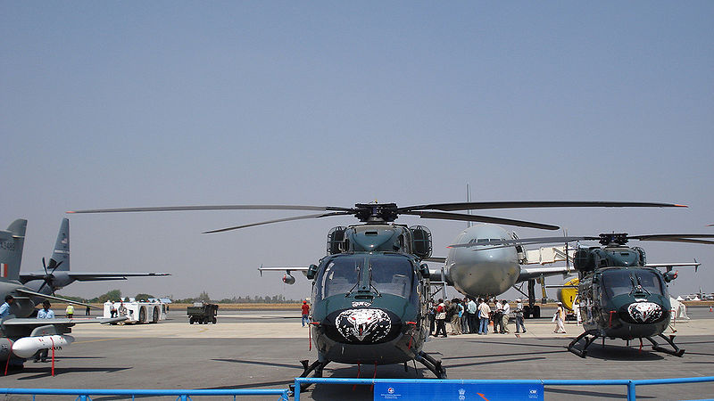
HAL Dhruv helicopter

Slide 10
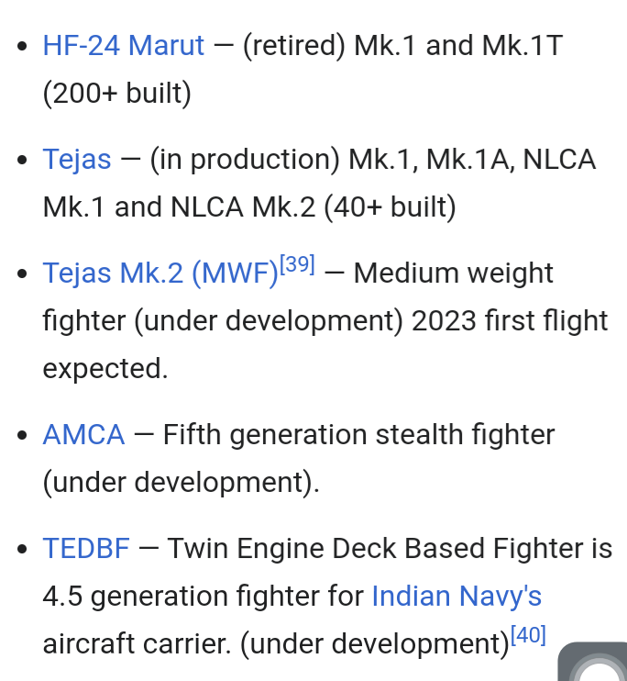

Slide 11
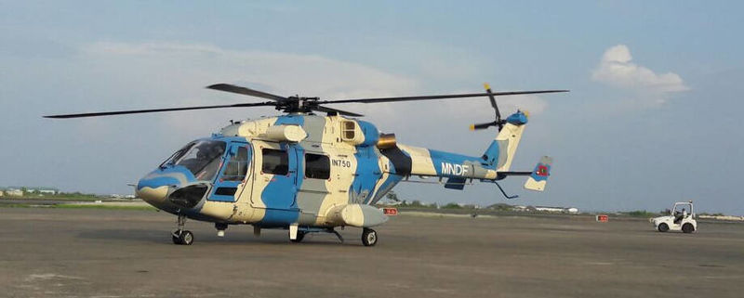
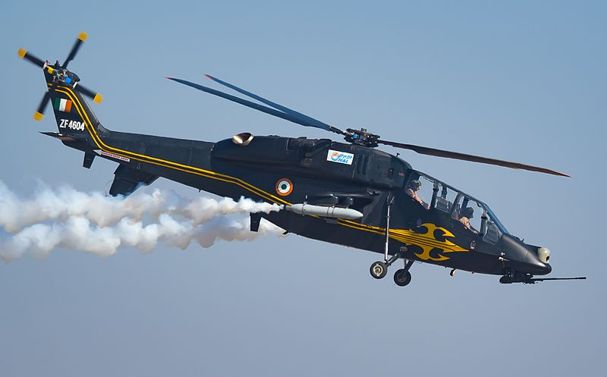
Helicopters LIGHT Combat helicopter

Slide 12
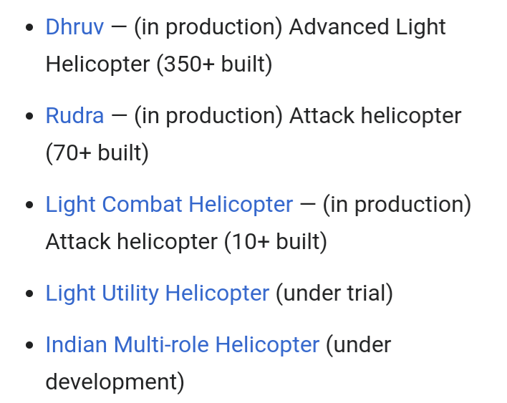

Slide 13
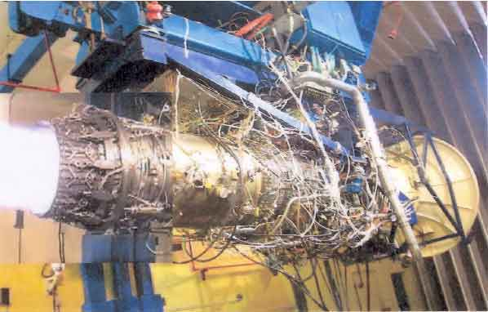
Engines GTX-35VS Kaveri

Slide 14
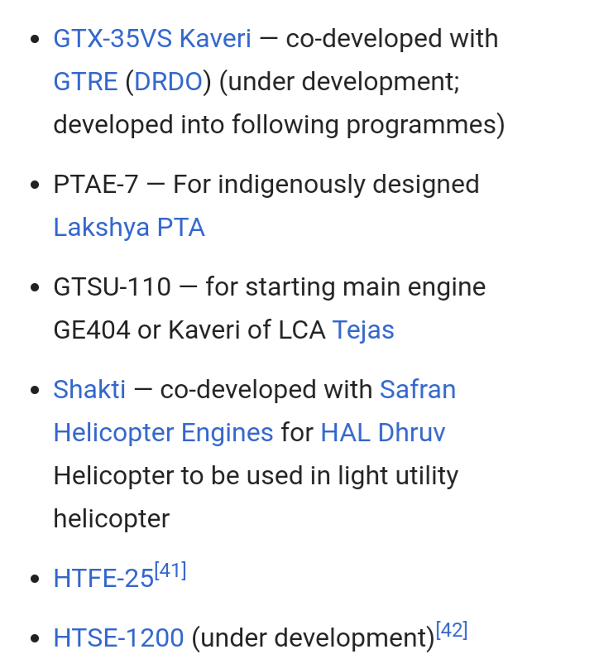

Slide 15
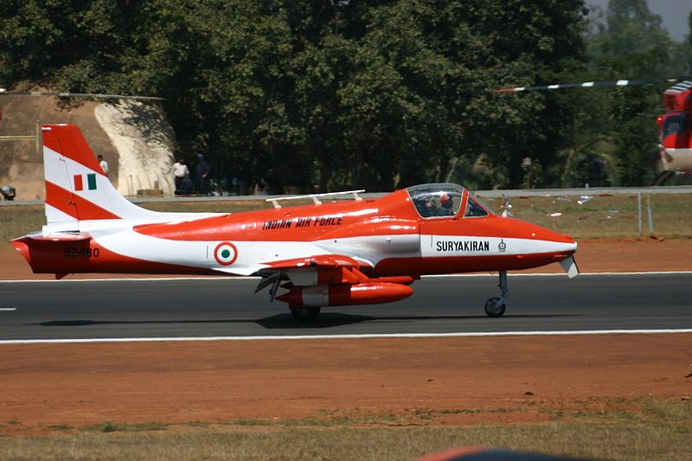
Trainer Aircraft HJT-16Kiran

Slide 16
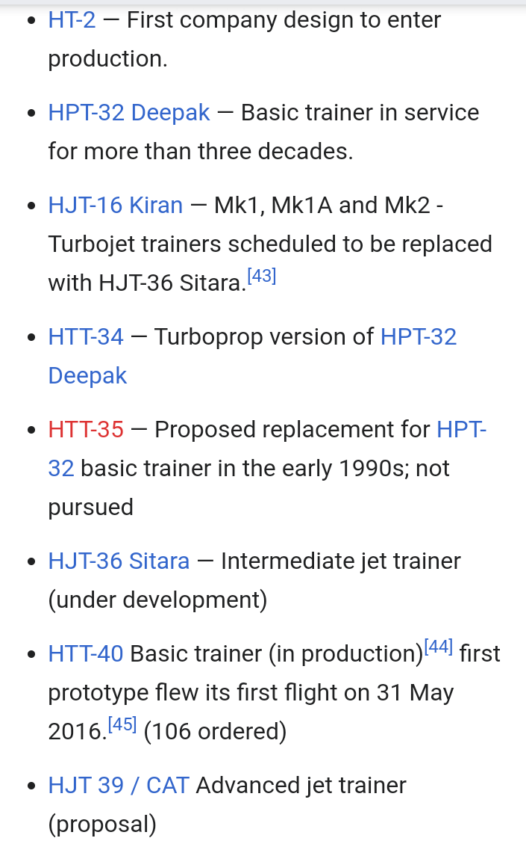

Slide 17
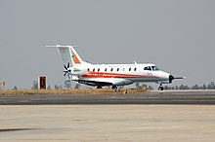
Transport and passenger aircraft Saras

Slide 18
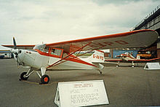
Utility aircraft HAL-26 Pushpak

Slide 19
Thank You

Slide 20
End

